Slide 1
Edward – Week 8 (1)
This past week, I continued testing for S3-related code files starting with the lowest code coverage file, the MainTabBar file.

Slide 2
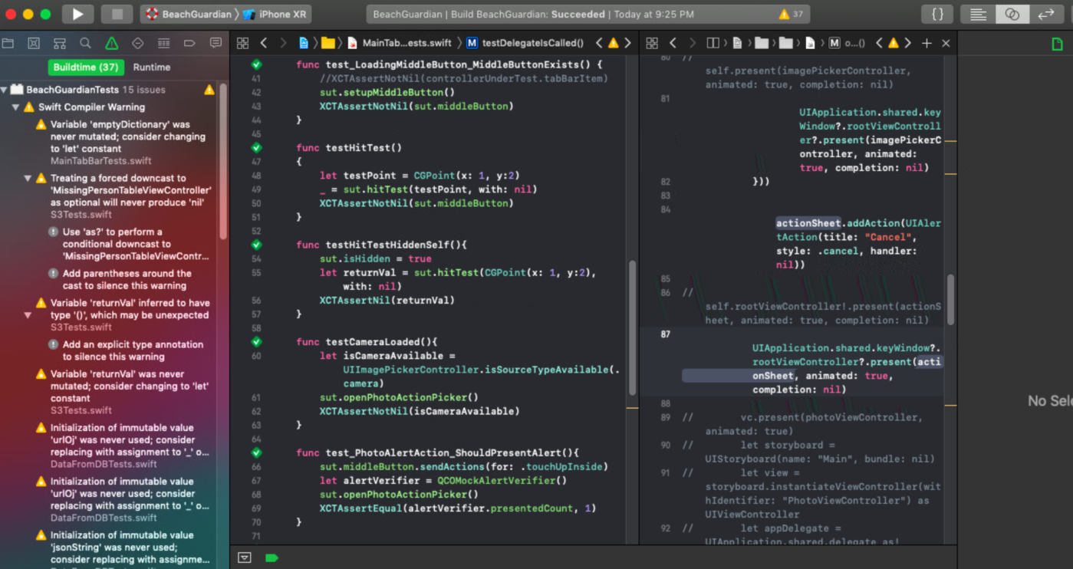
Edward – Week 8 (2)
Update to repo made on Sunday, 3/24
Tests passing for main tab bar
My week 8 goal is to continue developing using TDD and finish up the last lines of code that need testing. I also plan to start connecting the back and front end before the next iteration ends.
Planning to add to the new forms for the next week

